Slide 1

Bluetooth Control Home Automation using 8051
(8051 -5 Days Workshop)
DAY 10
EMBEDDED SYSTEM DESIGN & IoT-Master Class

Slide 2
What You will learn Today?
Bluetooth Control Home automation
Hardware Required
Software Required
Introduction to Bluetooth and Relay
Block Diagram
Schematics
Source Code

Slide 3
Mindset Lesson for the Day
You Become What You Think About all day long
Exercise
Write down all the thoughts you are associated with daily.
Analyze what to stop and what to nurture.
(Listen to the Audio “ The Strangest Secret” –Earl Nightingale)

Slide 4
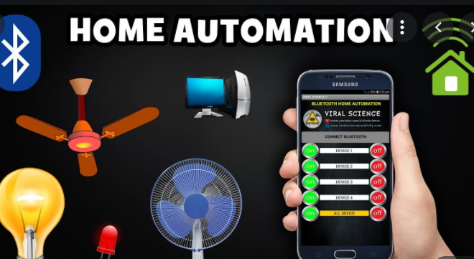
Bluetooth Control Home automation
Home automation system is designed which can be controlled by any Android smartphone. The automation system connects with the smartphone through Bluetooth. The smart phone sends control signals to switch home appliances ON or OFF by an android app through Bluetooth interface.

Slide 5
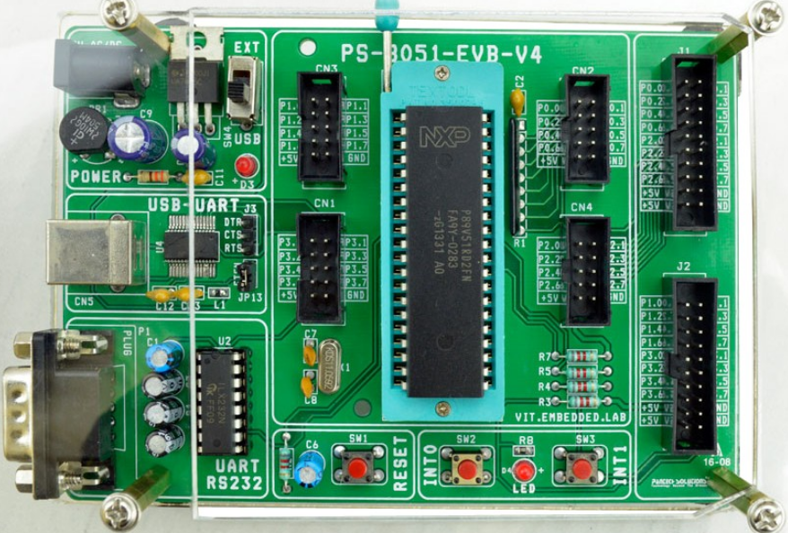
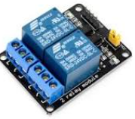
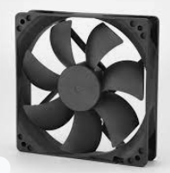

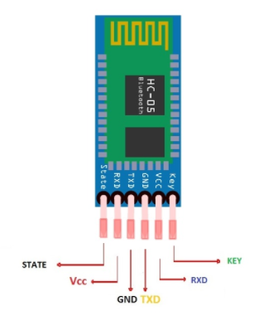
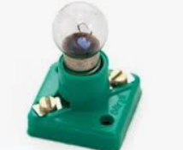
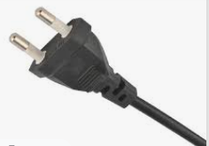
Hardware Required

Slide 6
Software required
Keil
Nuvoton ISP-ICP Utility
Hyper terminal
Android Bluetooth control(PLAY STORE)

Slide 7
What is Bluetooth
Bluetooth wireless technology is an open specification for a low-cost, low-power,
short-range radio technology for wireless communication of voice and data.
Bluetooth is a short-range wireless technology standard that is used for exchanging data between fixed and mobile devices over short distances using UHF radio waves in the ISM bands, from 2.402 GHz to 2.48 GHz, and building personal area networks.

Slide 8
Advantages of Bluetooth
Advantages
  Bluetooth: interoperable
  IrDA: line of sight needed, point-to-point
  WLAN: higher power consumption
Disadvantages
  Bluetooth: only up to 1 Mbps
  IrDA: much cheaper, faster (up to 16 Mbps)
  WLAN: faster (up to 11 Mbps)

Slide 9
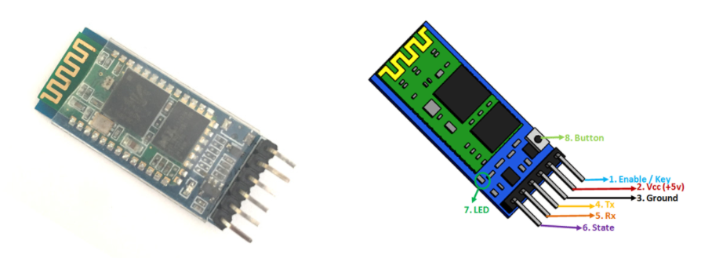
HC-05 Bluetooth Module

Slide 10
HC-05 Default Settings
Default Bluetooth Name: “HC-05”
Default Password: 1234 or 0000
Default Communication: Slave
Default Mode: Data Mode
Data Mode Baud Rate: 9600, 8, N, 1
Command Mode Baud Rate: 38400, 8, N, 1
Default firmware: LINVOR

Slide 11
Tech Specifications
Serial Bluetooth module for arduino other microcontrollers
Operating Voltage: 4V to 6V (Typically +5V)
Operating Current: 30mA
Range: <100m
Works with Serial communication (USART) and TTL compatible
Follows IEEE 802.15.1 standardized protocol
Uses Frequency-Hopping Spread spectrum (FHSS)
Can operate in Master, Slave or Master/Slave mode
Can be easily interfaced with Laptop or Mobile phones with Bluetooth
Supported baud rate: 9600,19200,38400,57600,115200,230400,460800.

Slide 12
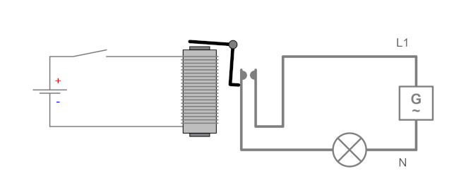
What is an Relay
A relay is an electrically operated switch. It consists of a set of input terminals for a single or multiple control signals, and a set of operating contact terminals.
The traditional form of a relay uses an electromagnet to close or open the contacts, but other operating principles have been invented, such as in solid-state relays which use semiconductor properties for control without relying on moving parts.

Slide 13
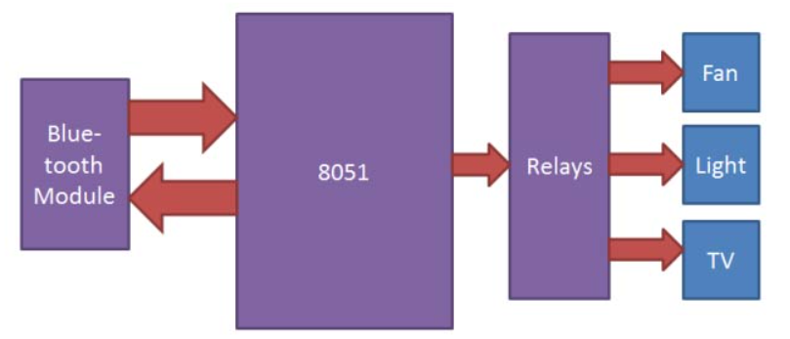
Block Diagram

Slide 14
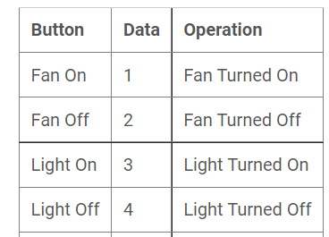
Serial Data

Slide 15
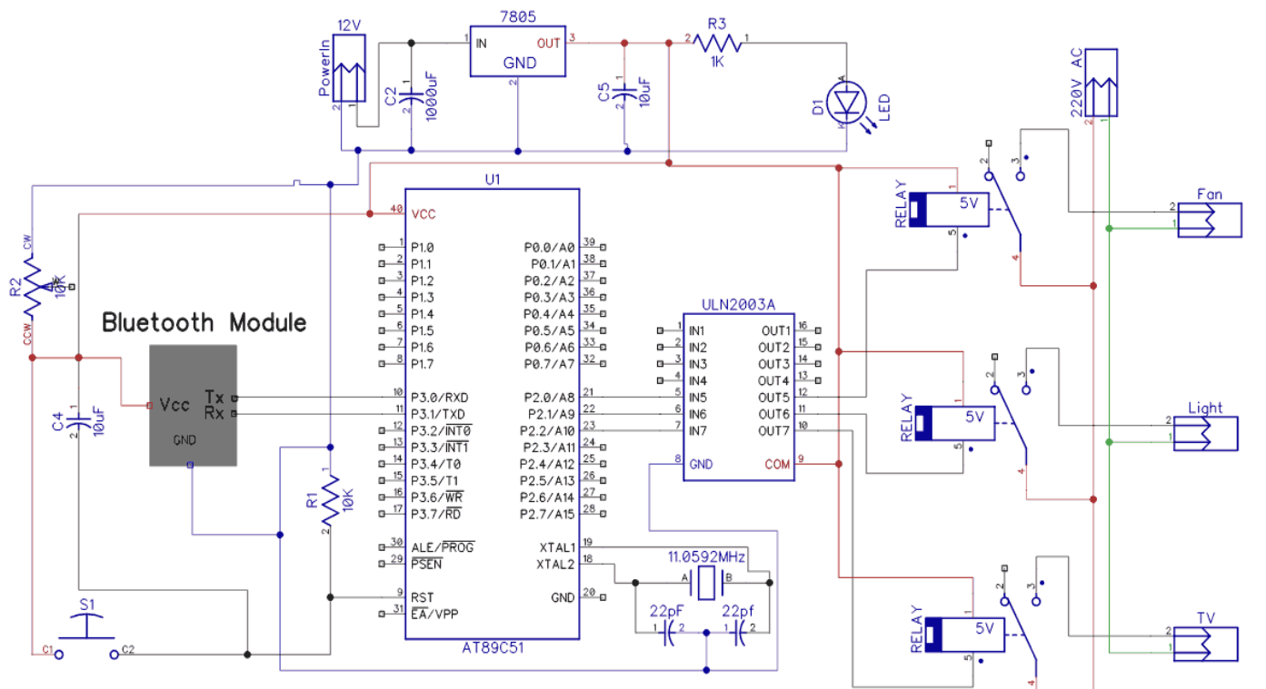
Circuit Diagram

Slide 16
Header file and Port Configuration
#include <reg51.h>
void UART_Init();
void UART_TxChar(char);
char UART_RxChar();
void UART_SendString(char *);
sbit Lamp =P2^0;
sbit Fan =P2^1;

Slide 17
UART Initialization
void UART_Init()
{
TMOD = 0x20;
TH1 = 0xFD;
SCON = 0x50;
TR1 = 1;
}

Slide 18
UART Transmit and Receive
void UART_TxChar(char Data)
{
SBUF = Data;
while (TI==0);
TI = 0;
}
char UART_RxChar()
{
char dat;
while (RI==0);
RI = 0;
dat = SBUF;
return(dat);
}

Slide 19
Transmit String
void UART_SendString(char *str)
{
int i;
for(i=0;str[i]!=0;i++)
{
UART_TxChar(str[i]);
}
}

Slide 20
void main()
{
char Data_in;
UART_Init(); /* initialize UART Tx=P3^0 and Rx=P3^1 */
P2 = 0; /* clear port initially */
Lamp = 1; /* initially Lamp turn OFF */
Fan = 1; /* initially Fan turn OFF */
while(1)
{
Data_in = UART_RxChar(); /* receive char serially */
UART_TxChar(Data_in);
if(Data_in == ‘1')
{
Lamp = 1; /* turn ON LED */
UART_SendString("Lamp_ON"); /* send status of LED*/
}
else if(Data_in == ‘2')
{
Lamp=0; /* turn OFF Lamp */
UART_SendString("Lamp_OFF"); /* send status of Lamp*/
}
else if(Data_in == ‘3’)
{
Fan = 1; /* turn ON Fan */
UART_SendString("Fan_ON"); /* send status of Fan*/
}
else if(Data_in == ‘4')
{
Fan=0; /* turn OFF LED */
UART_SendString("Fan_OFF"); /* send status of LED*/
}
else
{
UART_SendString("Select proper option"); /* send msg to select proper option */
}
}
}

Slide 21
Thank You

